Slide 1



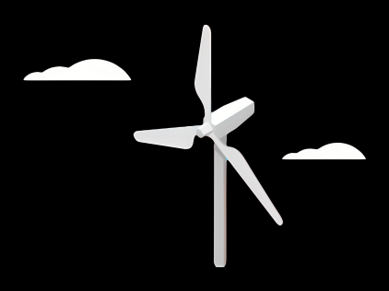
Weekly report: Team Gearbox, Brake, Coupling
Week number : 05
Date: 28/10/2025
Supervisor: Prof. Peter Quell
Group Members :Nehang Jitendra Joshi,Santo Mazumder,Md Razaul Karim Rahat
Presented by -Santo Mazumder
28-10-2025
Gearbox, Brake, Coupling

Slide 2
List of Content
Overview of technical terms
Gearbox configuration
Dimension of the gearbox
Geometric definitions/parameters for gears
Formula for planetary gears and spur
Elastomeric Bearing concept
Brake system
28-10-2025
Gearbox, Brake, Coupling

Slide 3
Overview
Drivetrain According to site conditions, CAPEX and OPEX we found the best solution that is “3-point Suspension System”
Gearbox 3 stages of the gearbox : 2 planetary and 1 spur gear stages
Brake Hydraulic brake-Svendborg BSAK 300 DUAL-ACTION
Coupling
Bolted flange connection
28-10-2025
Gearbox, Brake, Coupling

Slide 4
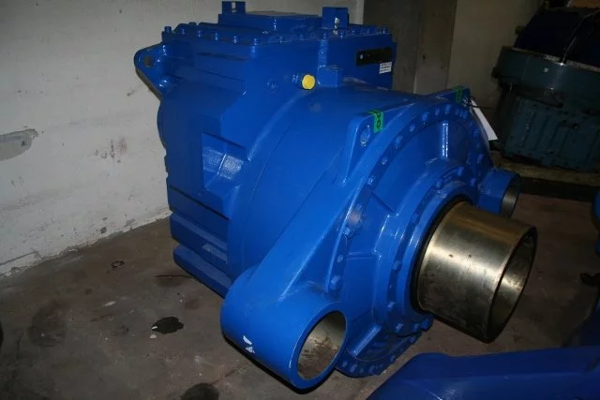
Gear box configuration
Gearbox:
Bonfiglioli Transmissions for Pitch Gearbox
Model/Name: 705T3N (gearbox ratio = 176.5:1)
Winenergy AG for Main Gearbox
Model/Name: PEAB 4320 (2- Planetary & 1- spur)
Source: https://www.sparesinmotion.com/
28-10-2025
Gearbox, Brake, Coupling

Slide 5
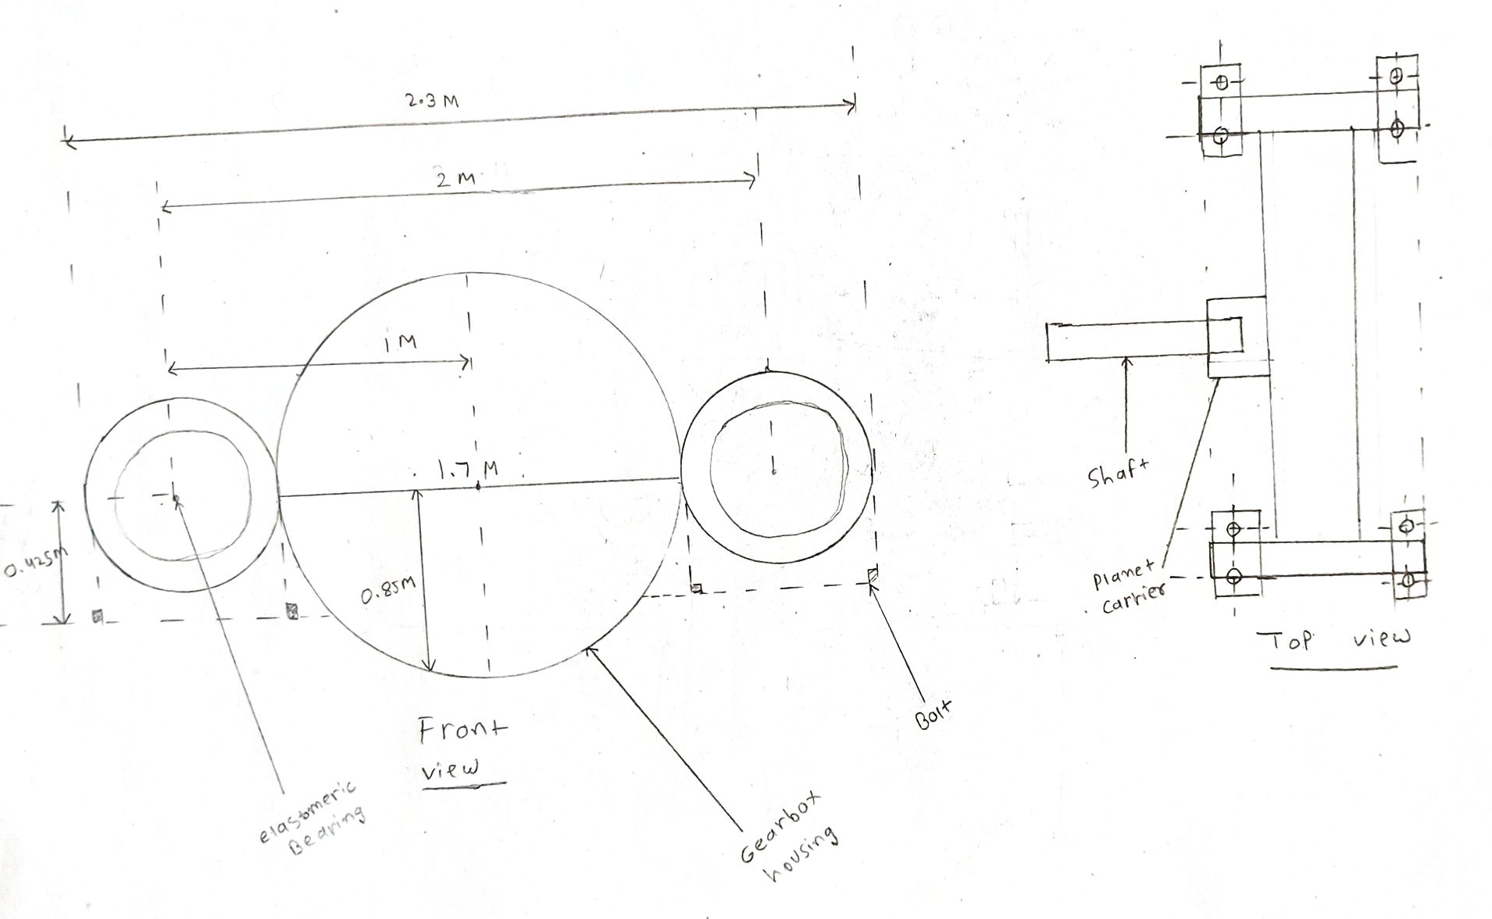
Dimension overview of the gearbox
Source: Own sketch
28-10-2025
Gearbox, Brake, Coupling

Slide 6
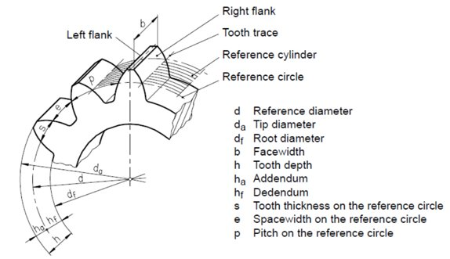
Geometric definitions/parameters
28-10-2025
Gearbox, Brake, Coupling

Slide 7
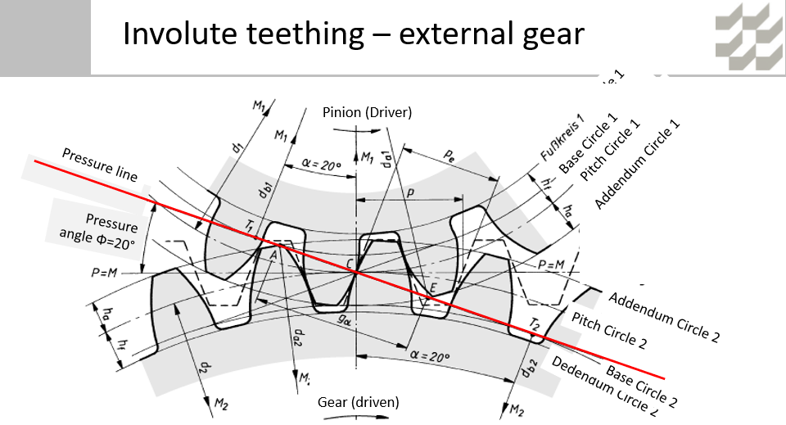
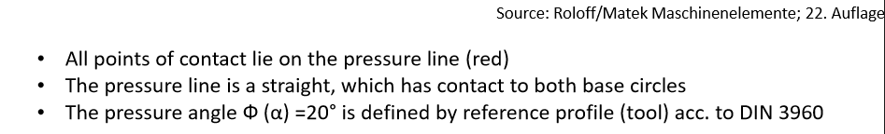

28-10-2025
Gearbox, Brake, Coupling

Slide 8
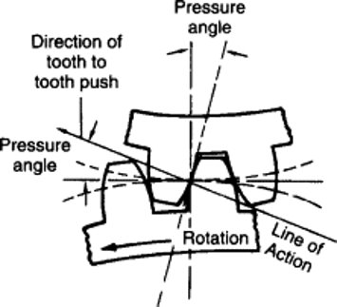
pressure angle!
is the angle at which the pressure from the tooth of one gear is passed on to the tooth of another gear.
Normal pressure angles in use today are between 17.5° and 22.5°
𝛼 = 20°.
28-10-2025
Gearbox, Brake, Coupling

Slide 9
Formulas for Planetary gear
z_Ring | z_Sun +( 2 x z_Planet)
z_Planet | z_Sun + z_Ring
No. of Planets | 3
D_Sun | z_Sun x Module
D_Planets | (D_Ring /2) – (D_Sun/2)
D_Ring | z_Ring x Module
Gap | (D_Sun + D_Planets) * Pi / (No. of Planets) - D_Planets
Face Width | 10 x Module
Tooth Depth | 2.25 x Module
n_Ring | 0
n_Planet Carrier | 15
n_Sun | (1-i_1) x n_Planet Carrier
i_Sun,Planet | z_Planet / z_Sun
n_Planet | n_Sun / i_Sun,Planet
z = No. of Teeth
n = RPM
D = Pitch Circle Diameter
i = Gear Ratio
Reference: Lecture Notes by Prof. Peter Quell
28-10-2025
Gearbox, Brake, Coupling

Slide 10
Spur Gear Selection
S No | Parameter | Options | Selection | Justification
1 | Tooth Profile | Involute / Cycloidal | Involute | Easy to Cut & Pressure Angle remains Constant
2 | Pressure Angle | 14.5 / 20 / 25 | 20 | Compromise between Cost & Size of Entire Gearbox
3 | Type of Tooth | Full Depth / Stub Tooth | Full Depth | Power Transmission is Smooth
4 | Quality Of Cut | Comercially cut / Carefully cut / Precision cut | Precision Cut | To Avoid Pitting Failure & Dynamic Loading
5 | Type of System | Open / Closed | Closed | To Prevent Abrasive Wear
6 | Type of Gearing | Corrected / Non-Corrected | Non-Corrected | Easy to Design, Interchangeable
7 | Geometry | Symmetric / Unsymmetric | Unsymmetric | Compact & Low cost
Reference: https://dlscrib.com/download/psg-design-data-book-me6503-design-of-machine-elementspdf_5a8cf4d7e2b6f5c75a8c30ff_pdf accessed on 10-20-9
28-10-2025
Gearbox, Brake, Coupling

Slide 11
Formulas used for spur gear selection
Step 1: Number of teeth and pinion gear
Step 2: Calculation of lewis form factor
Step 3: Material selection
Step 4: Determination of the weaker member
Step 5: Design of weaker member
No. of tooth in pinion | Z1 = 2f/sin^2 (Alpha)
Number of tooth on gear | Z2 =Z1 / i
Spur gear ratio | N2/N1 = I
Cal. of lewis form factor | Y1 = Pi (0.154 -(0.912 / z1))
Pinion, Gear | Forged steel
For Pinion & Gear | S1 = Sigma b * Y1
Design based on bending (m) | 1.26 *{ [M_T]/(Y1 * Sigma b1 * ϕ_M * Z1)} ^(1/3)
28-10-2025
Gearbox, Brake, Coupling

Slide 12
Formulas used for spur gear selection
Step 6: Checking of the contact stresses
Step 7: Checking of the dynamic load (Fs > Fd)
Step 8: Checking of wear load (Fw > Fd)
Step 9: Constructional details
Contact stress(sigma c) | 0.74 *((i+1)/a)*sqrt(((i+1)/(i*b))*E*[M_T])
Strength on the gear (Fs) | sigma b1 * b* Y1 *m
Dynamic Load acting on gear (Fd) | F_T * CV
F_W | d1 * Q *b* k
Circular Pitch (Pc) | Pi * m
Pinion (n1) | 0.55 * (Pc * Z1*Z1)^(1/4)
Gear (n2) | 0.55 * (Pc * Z2*Z2)^(1/4)
28-10-2025
Gearbox, Brake, Coupling

Slide 13
Verification of Pin for Elastomeric Bearing
Pin : Functions and Geometry
Pin
Pin mounted in Torque arm
Gearbox with Torque arm
Source: http://dx.doi.org/10.7735/ksmte.2017.26.2.199
Detailed view of Pin
28-10-2025
Gearbox, Brake, Coupling

Slide 14
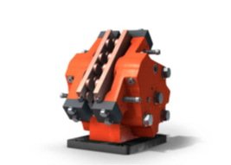
Brake system
• Few moving parts, resulting in easy maintenance and reduced costs
• Small air gap combined with few moving parts, which mean short response time and fast braking
• Different types of spring packages available, reducing loss of force and providing higher levels of safety
• Drain ports for hydraulic oil leakage, preventing the presence of oil on brake discs and further increasing safety levels
• Tested down to -40°C
High Speed Shaft (Active Hydraulic)
Disc Brake: BSAK 300 DUAL-ACTION
Source : https://www.svendborg-brakes.com/media/136327/data_sheets_catalogue.pdf
28-10-2025
Gearbox, Brake, Coupling

Slide 15
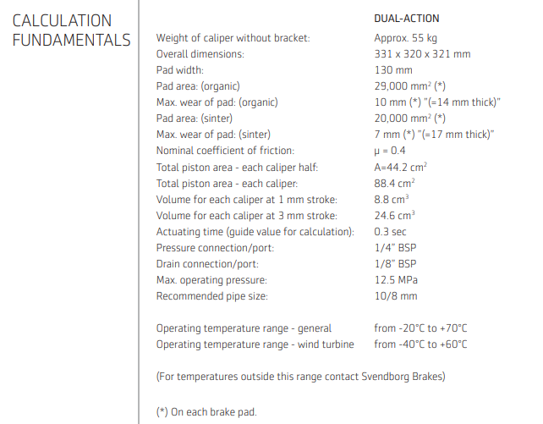
BSAK-300 Dual Action
28-10-2025
Gearbox, Brake, Coupling

Slide 16
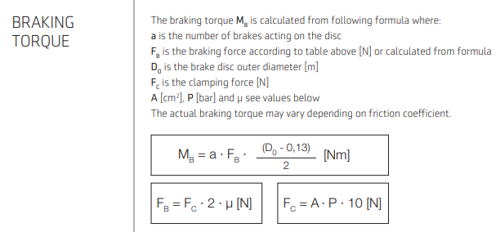
BSAK-300 Dual Action
28-10-2025
Gearbox, Brake, Coupling

Slide 17
Bibliography
Gearbox
(1) Previous year Optimus projects 26-10-2025
(2) IEC-61400-4 and DNV-GL 26-10-2025
(3) Lecture notes – Mechanical drive train by Prof.Peter Quell.25-10-2025
(4)ZF Wind and Winergy website 24-10-2025
Brake
(1)Lecture Notes Mechanical Drivetrain 27-10-2025
(2)Svendborg Brake Manual 25-10-2025
(3)Previous year Optimus projects 26-10-2025
28-10-2025
Gearbox, Brake, Coupling

